Slide 1


Slide 2
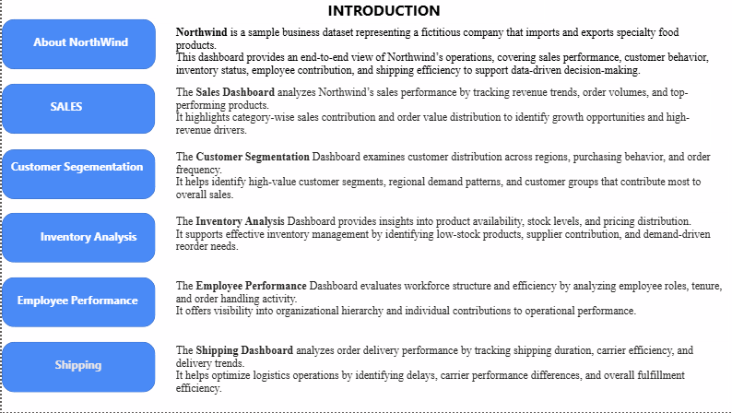

Slide 3


Slide 4


Slide 5
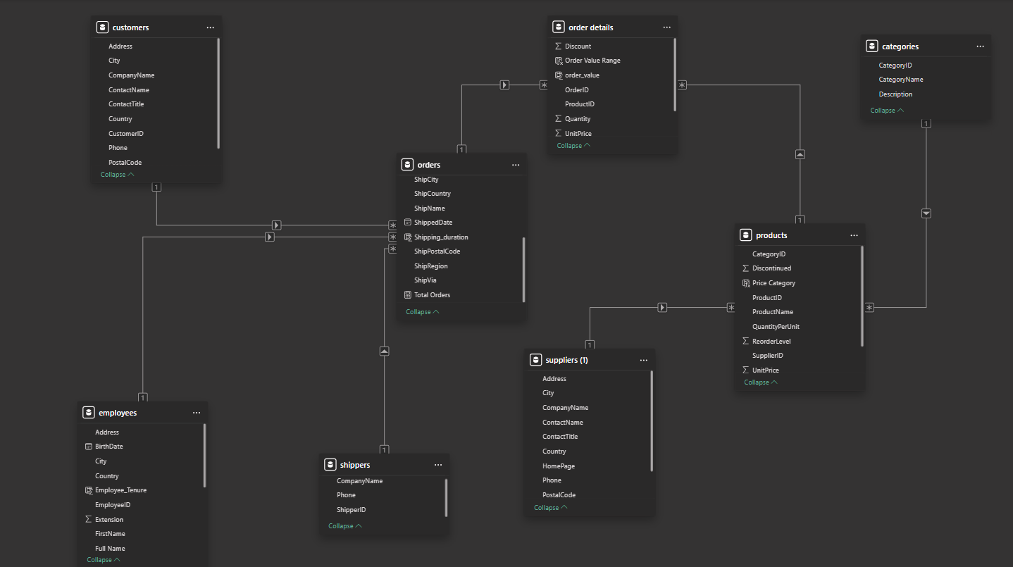
ER DIAGRAM

Slide 6


Slide 7
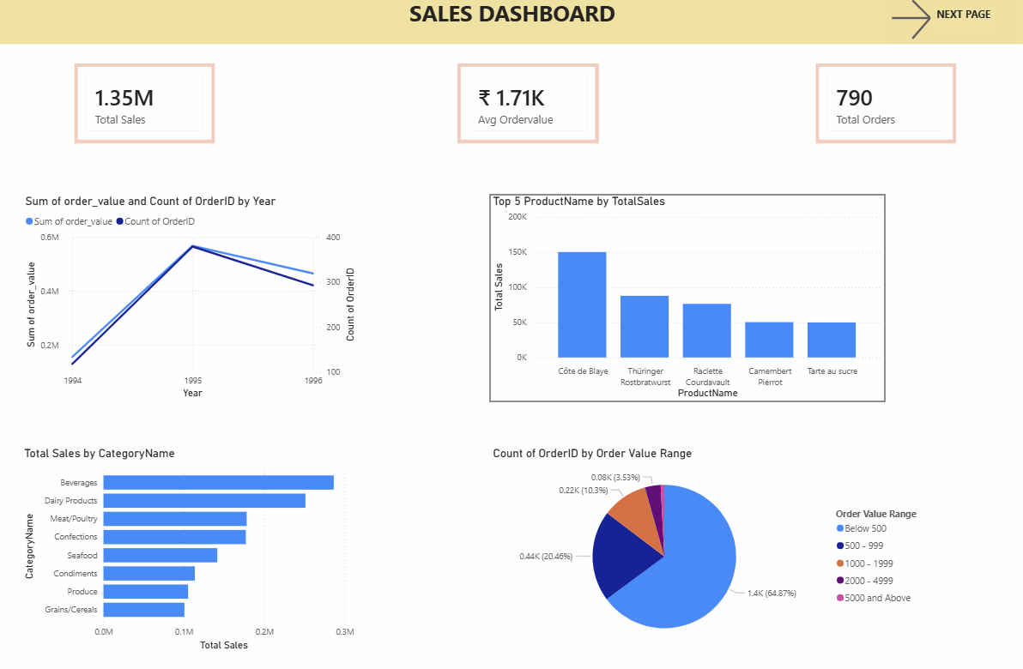

Slide 8
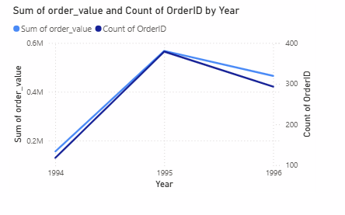
How do total sales value and order volume change over time?
The chart shows a strong growth in both total sales value and order volume from 1994 to 1995, indicating a period of rapid business expansion. In 1996, both metrics show a moderate decline; however, they remain significantly higher than 1994 levels. This suggests that while the business experienced a slight slowdown after peak performance in 1995, overall sales activity continued to remain strong.

Slide 9
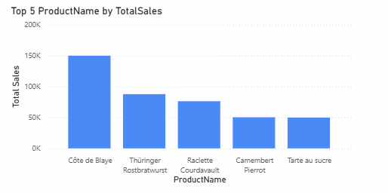
Which products generate the highest total sales revenue?
The chart shows that Côte de Blaye is the highest revenue-generating product, contributing significantly more sales than other products. It is followed by Thüringer Rostbratwurst and Raclette Courdavault, which also generate strong revenue. The remaining products, Camembert Pierrot and Tarte au sucre, contribute comparatively lower but still substantial sales. This indicates that a small number of products act as key revenue drivers for the business.

Slide 10
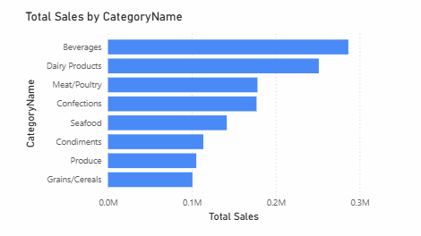
How does total sales vary across different product categories?
The chart shows that Beverages is the highest-performing category, generating the maximum total sales. This is followed by Dairy Products and Meat/Poultry, which also contribute significantly to overall revenue. Categories such as Grains/Cereals, Produce, and Condiments generate comparatively lower sales. This indicates that sales performance is uneven across categories, with a few categories acting as major revenue drivers.

Slide 11
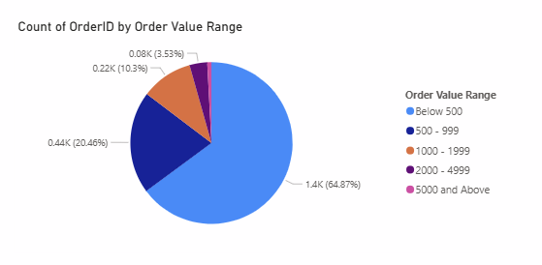
How are orders distributed across different order value ranges?
The pie chart shows that the majority of orders fall within the Below 500 order value range, accounting for nearly 65% of total orders. This is followed by the 500–999 range, which contributes around 20% of orders. Higher-value orders above 1000 form a relatively small portion of total orders. This indicates that the business is driven primarily by a high volume of low to mid-value orders, with only a few high-value transactions.

Slide 12
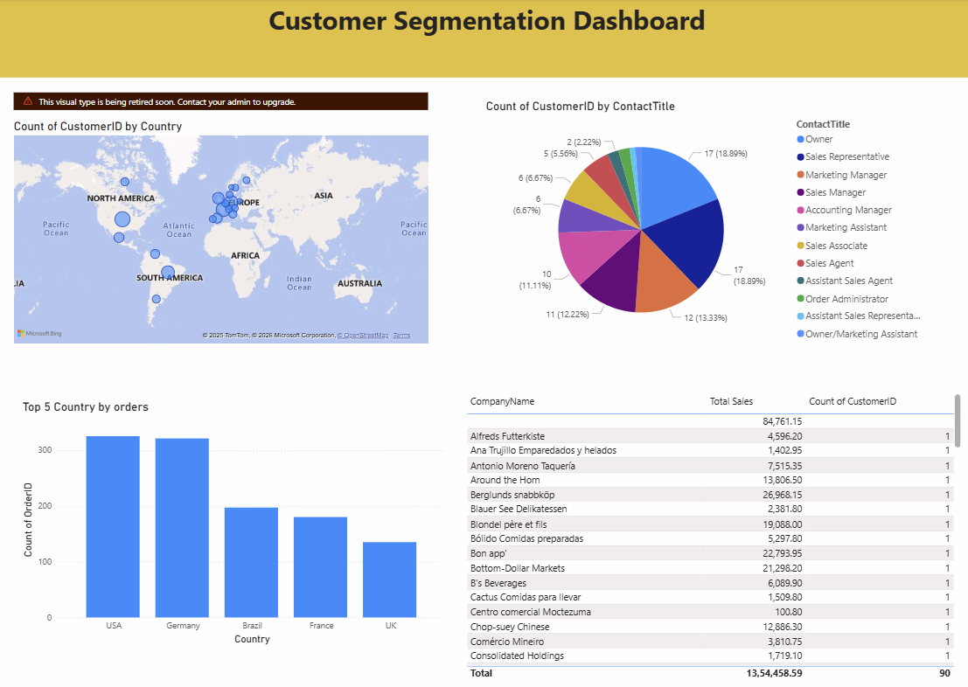

Slide 13
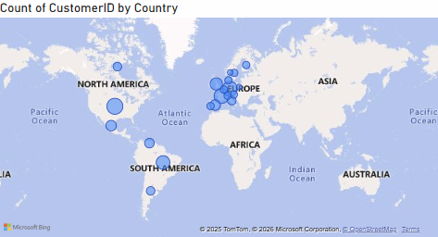
How are customers distributed across different countries?
The map shows that customers are primarily concentrated in Europe, followed by North America. Other regions such as South America and Asia have a smaller customer presence. This indicates that Northwind’s customer base is geographically concentrated, with Europe acting as the company’s primary market.

Slide 14
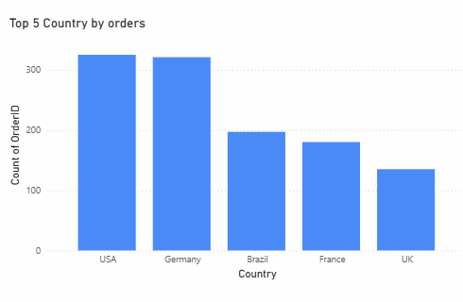
Which countries generate the highest number of customer orders?
The chart shows that the USA and Germany generate the highest number of orders, making them the top-performing countries in terms of order volume. They are followed by Brazil, France, and the UK, which contribute a moderate number of orders. This indicates that order activity is concentrated in a few key countries, with the USA and Germany acting as major markets for the business.

Slide 15
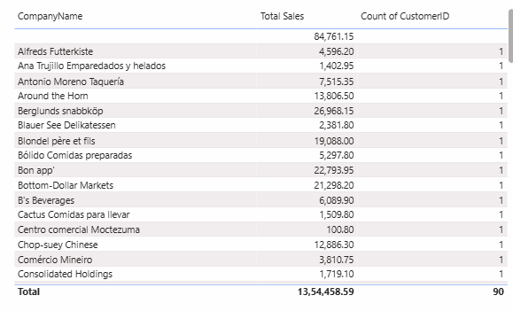
How does total sales vary across different customers (companies)?
The table shows that sales contribution varies significantly across customers. A small number of customers, such as Alfreds Futterkiste, generate relatively higher total sales, while most other customers contribute smaller individual sales amounts. Additionally, each customer is associated with a limited number of orders, indicating that revenue is unevenly distributed across the customer base.

Slide 16
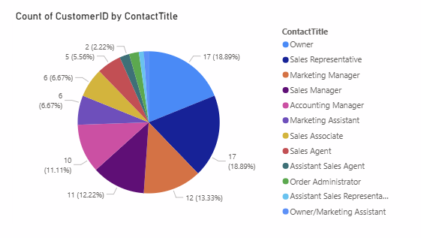
How are customers distributed across different contact titles?
The chart shows that customers are spread across multiple contact titles, with Owners and Sales Representatives forming the largest segments. This is followed by roles such as Marketing Managers, Sales Managers, and Accounting Managers. Other roles like Sales Agents, Marketing Assistants, and Administrative roles make up smaller portions. This indicates that purchasing decisions are primarily handled by senior or sales-related roles within customer organizations.

Slide 17
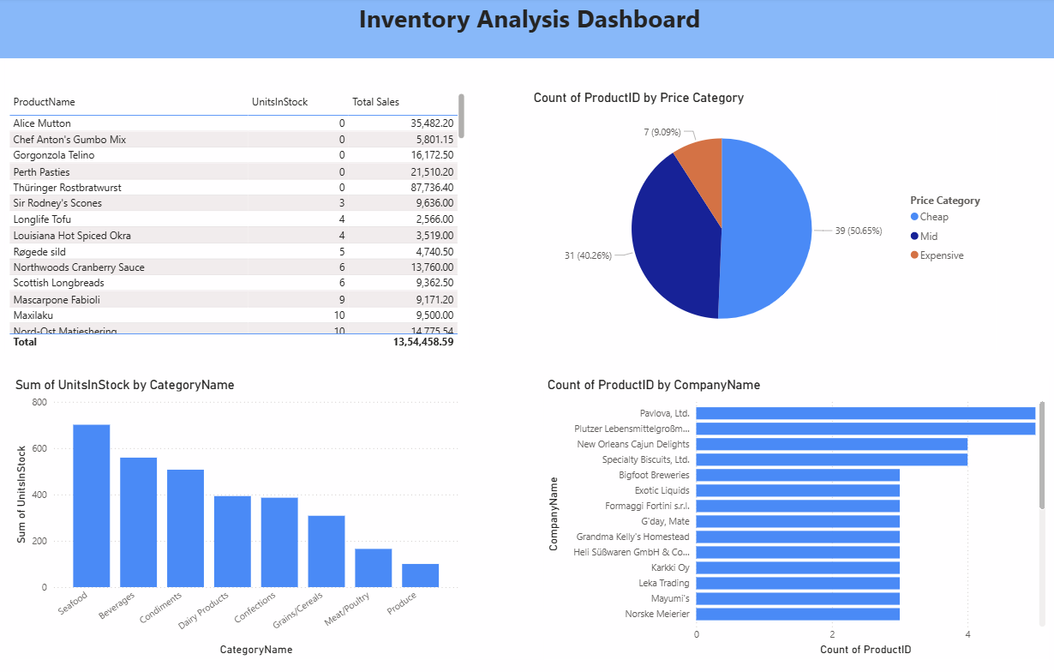

Slide 18
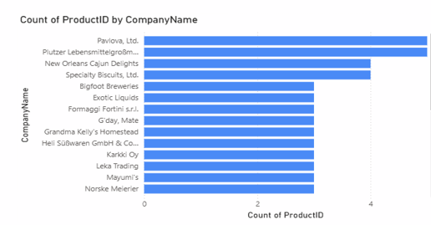
How many products are supplied by each supplier, and are there any key supplier dependencies?
The chart shows that suppliers such as Pavlova Ltd. and Plutzer Lebensmittelgroßmärkte supply the highest number of products compared to other suppliers. Most remaining suppliers contribute only a limited number of products. This indicates that the business relies more heavily on a few key suppliers, which may increase supply chain risk if disruptions occur.

Slide 19
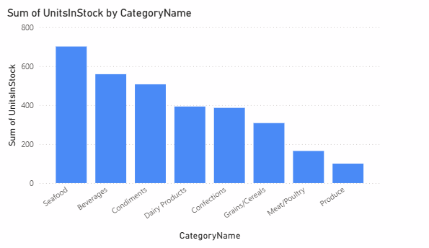
How is inventory distributed across different product categories?
The chart shows that Seafood and Beverages have the highest inventory levels, while categories such as Produce and Meat/Poultry have relatively lower stock. This suggests that inventory allocation is uneven across categories, potentially leading to overstocking in some categories and shortages in others

Slide 20
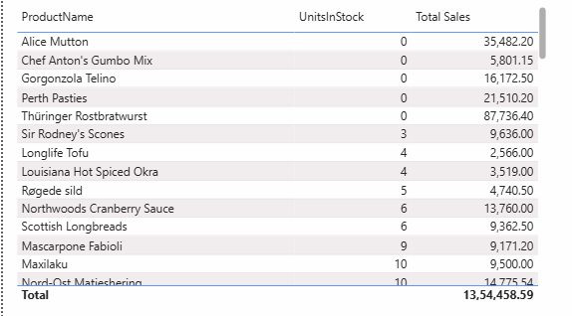
Which products have low or zero stock despite having sales, indicating potential stock-out risk?
The table shows that several products such as Alice Mutton, Chef Anton’s Gumbo Mix, and Thüringer Rostbratwurst have zero units in stock while still generating significant sales. This indicates a high risk of stock-outs, which could lead to lost sales and customer dissatisfaction if not addressed promptly.

Slide 21
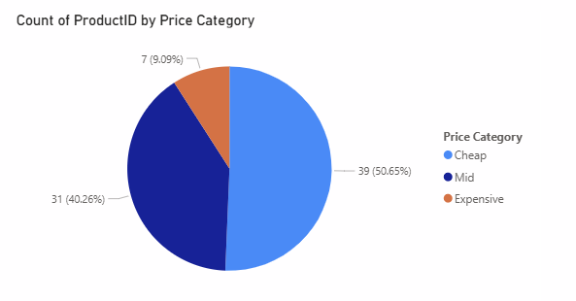
How are products distributed across different price categories?
The chart shows that the majority of products fall under the Cheap category, followed by Mid-priced products. Only a small proportion of products are classified as Expensive. This indicates that the business primarily follows a mass-market pricing strategy, focusing on affordable products.

Slide 22
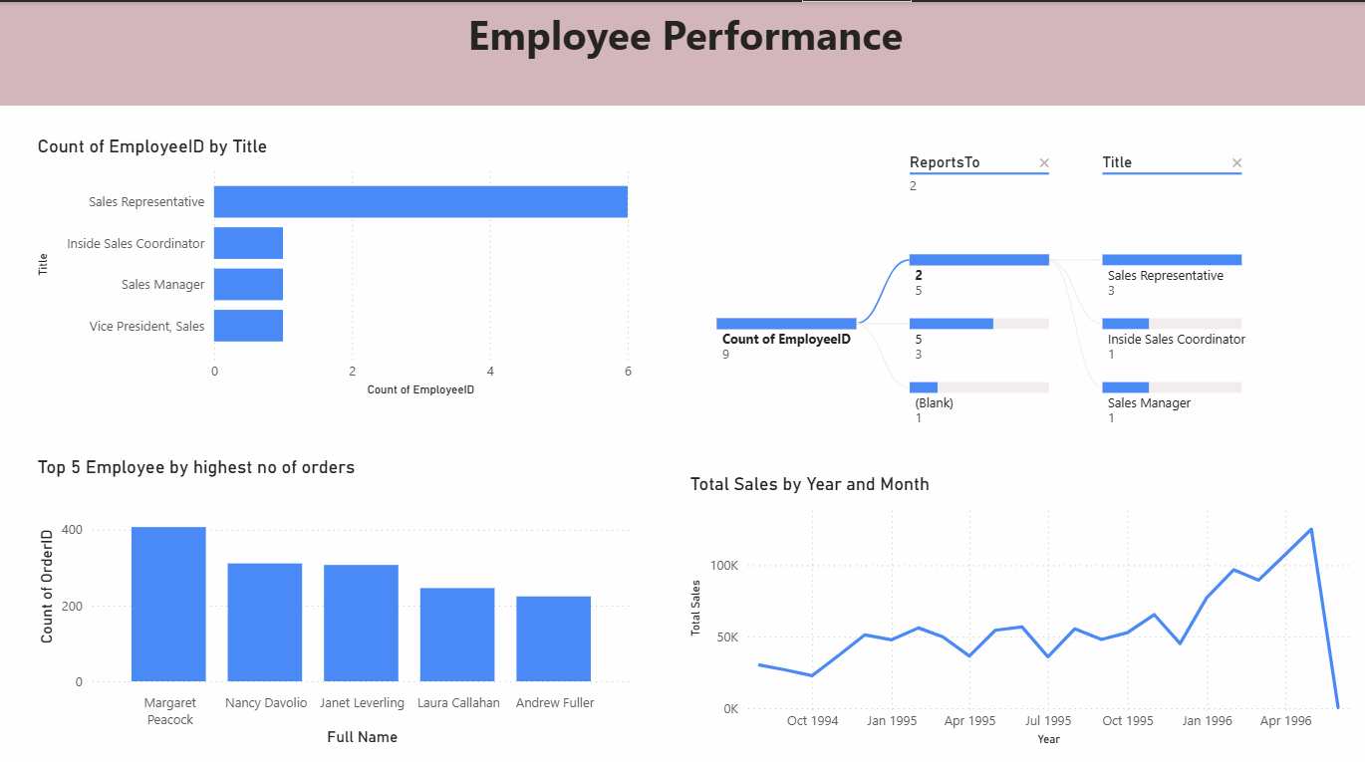

Slide 23
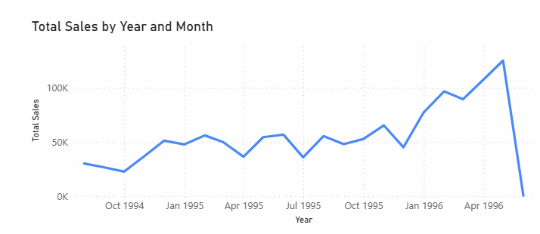
How has total sales performance evolved over time?
The chart shows a general upward trend in total sales over time, with periodic fluctuations. Sales peak toward the end of the timeline, indicating improved performance in later periods. Short-term dips suggest seasonal variation, but the overall trend reflects business growth supported by employee sales efforts.

Slide 24
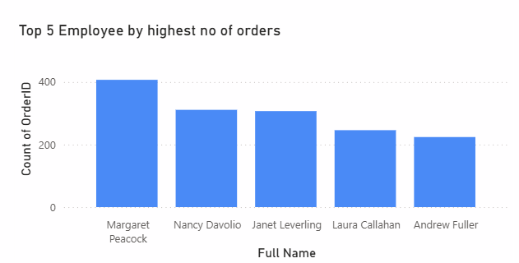
Which employees handle the highest number of customer orders?
The chart shows that Margaret Peacock has handled the highest number of orders, followed by Nancy Davolio and Janet Leverling. This indicates that order handling is concentrated among a few high-performing employees, while others handle comparatively fewer orders.

Slide 25
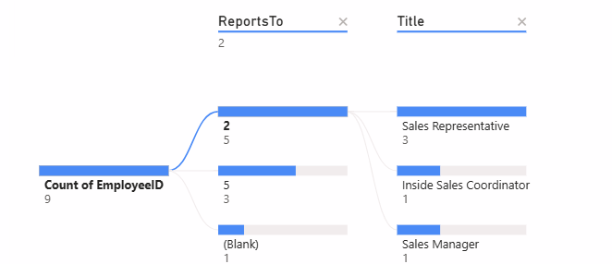
What is the reporting structure among employees?
The visual shows a clear reporting hierarchy, where multiple employees report to specific managers. Sales Representatives and Coordinators primarily report to higher-level roles such as Sales Managers. This indicates a well-defined organizational structure with clear lines of responsibility and supervision.

Slide 26
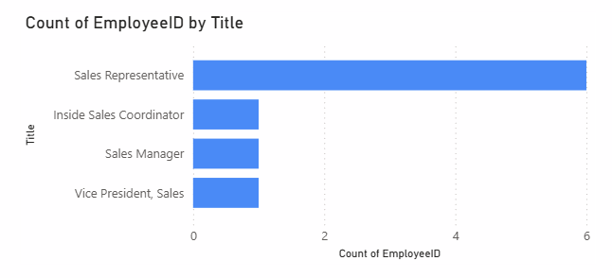
How is the workforce distributed across different job titles?
The chart shows that Sales Representatives form the majority of the workforce, while roles such as Inside Sales Coordinator, Sales Manager, and Vice President of Sales have significantly fewer employees. This indicates that the organization follows a sales-driven structure, with more operational staff and fewer managerial roles.

Slide 27
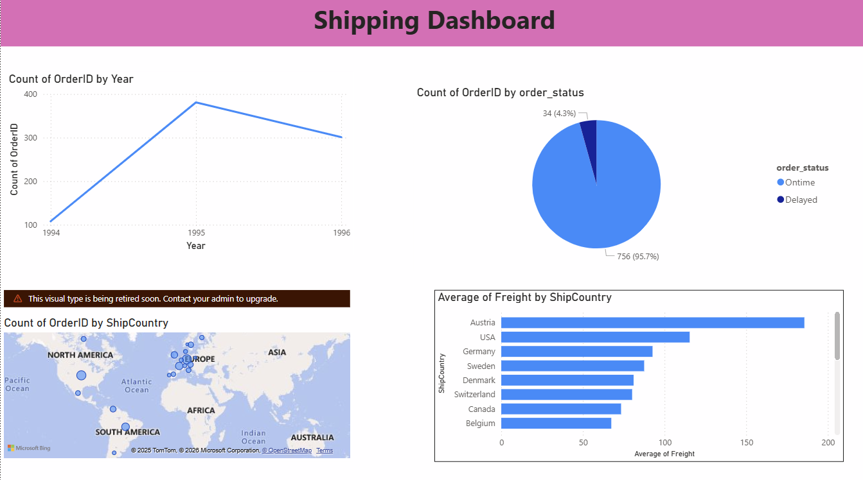

Slide 28
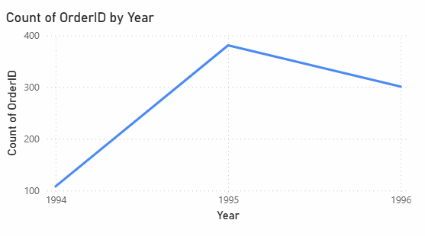
How has shipping volume changed over time?
The chart shows that the number of orders shipped increased significantly from 1994 to 1995, indicating a peak in shipping activity. In 1996, the order count declined slightly but remained higher than 1994 levels. This suggests that shipping volume followed overall business growth with minor fluctuations.

Slide 29
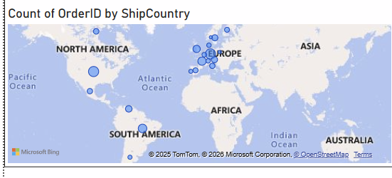
Which regions receive the highest number of shipments?
The map shows that the majority of shipments are concentrated in Europe and North America, with fewer shipments to other regions. This indicates that these regions are the company’s primary delivery markets.

Slide 30
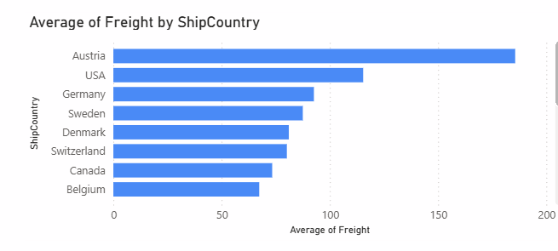
How does average freight cost vary across different destination countries?
The chart shows that countries such as Austria and the USA have the highest average freight costs, while countries like Belgium and Canada incur lower shipping costs. This variation suggests that shipping distance, regional logistics, and delivery complexity impact freight expenses.

Slide 31
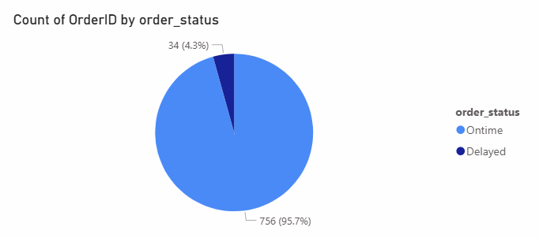
What proportion of orders are delivered on time versus delayed?
The pie chart shows that approximately 96% of orders are delivered on time, while only about 4% experience delays. This indicates a highly reliable shipping process, with minimal delays affecting customer satisfaction.

Slide 32
